Slide 1

Learning to Detect Sepsis with a Multitask Gaussian Process RNN Classifier
Joseph Futoma, Sanjay Hariharan, Katherine Heller ∙ 2017
By Simone Riedi∙ May 2021 ∙

Slide 2
Map
Problem Settings
Sepsis disease
Related work
Dataset and Notation
Why MGP?
Multitask Gaussian Process
Gaussian Process
Multitask Gaussian Process
RNN classifier
Dataset
Classifier
Loss Function
Experiments and Results
Critics

Slide 3
Problem Settings
Sepsis disease · Related Work · Dataset and Notation · Why MGP?
Sepsis := Destructive host response to the invasion of a microorganism or its toxin
Early identification is crucial
Symptoms may be caused by many other conditions
Hard to accurately detect it in time, even for expert clinicians

Slide 4
Problem Settings
Sepsis disease · Related Work · Dataset and Notation · Why MGP?
Early Warning Scores
Regression based approaches
Machine Learning
Based on comparison of vital signs (respiratory rate, oxygen saturation, temperature,..) to thresholds
Examples: MEWS, NEWS, SOFA, qSOFA scores
Use of clinical time series data
Examples: Rothman Index, Cox Regression
Main challenges: Very fast predictions, missing values, different amount of information across patients
Clustering approaches of time series using specific distance metrics
Long-Short Term Memory RNN
Respiratory rate (breaths/min) | > 35 | 31-35 | 21-30 | 9-20

Slide 5
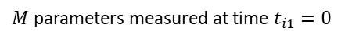
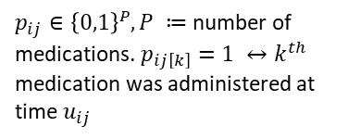
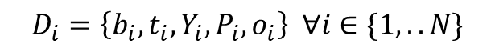

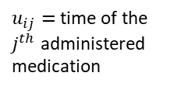
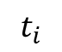
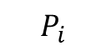
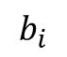
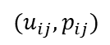
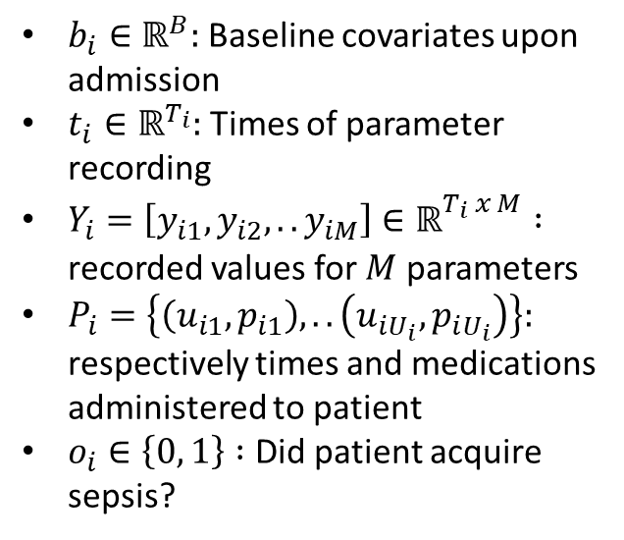
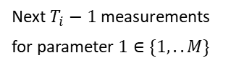
Problem Settings
Sepsis disease · Related Work · Dataset and Notation · Why MGP?
$$D_{i}=\left\{b_{i}, t_{i}, Y_{i},P_{i},o_{i}\right\} ∀i∈\{1,..N\}$$
$$Y_{i}$$
$$b_{i}$$
$p_{ij}∈{\left\{0,1\right\}}^{P}, P ≔$ number of medications. $p_{ij\left[k\right]}=1 ↔k^{th}$ medication was administered at time $u_{ij}$
$M$ parameters measured at time $t_{i1}=0$
Age
$b_{i}∈ℝ^{B}:$ Baseline covariates upon admission
$t_{i}∈ℝ^{T_{i}}:$ Times of parameter recording
$Y_{i}=\left[y_{i1},y_{i2},..y_{iM}\right]∈ℝ_{}^{T_{i} x M} :$ recorded values for $M$ parameters
$P_{i}=\left\{\left(u_{i1}, p_{i1}\right),..\left(u_{iU_{i}},p_{iU_{i}}\right)\right\}:$ respectively times and medications administered to patient
$o_{i}∈\left\{0, 1\right\} :$ Did patient acquire sepsis?
Gender
$$t_{i}$$
$u_{ij}=$time of the $j^{th}$ administered medication
0
Next $T_{i}−1$ measurements for parameter $1∈\{1,..M\}$
$$P_{i}$$
$$(u_{ij},p_{ij})$$

Slide 6

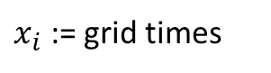
Problem Settings
Sepsis disease · Related Work · Dataset and Notation · Why MGP?
Original Parameter Recordings
After MGP
Problem: irregular time intervals between measurements
Solution: Find parameters at evenly spaced grid times
$$t_{i}$$
$x_{i}$ := grid times
Time Axis
Vector of parameters
Time Axis
Vector of parameters

Slide 7
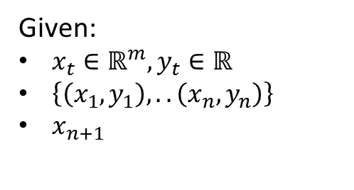
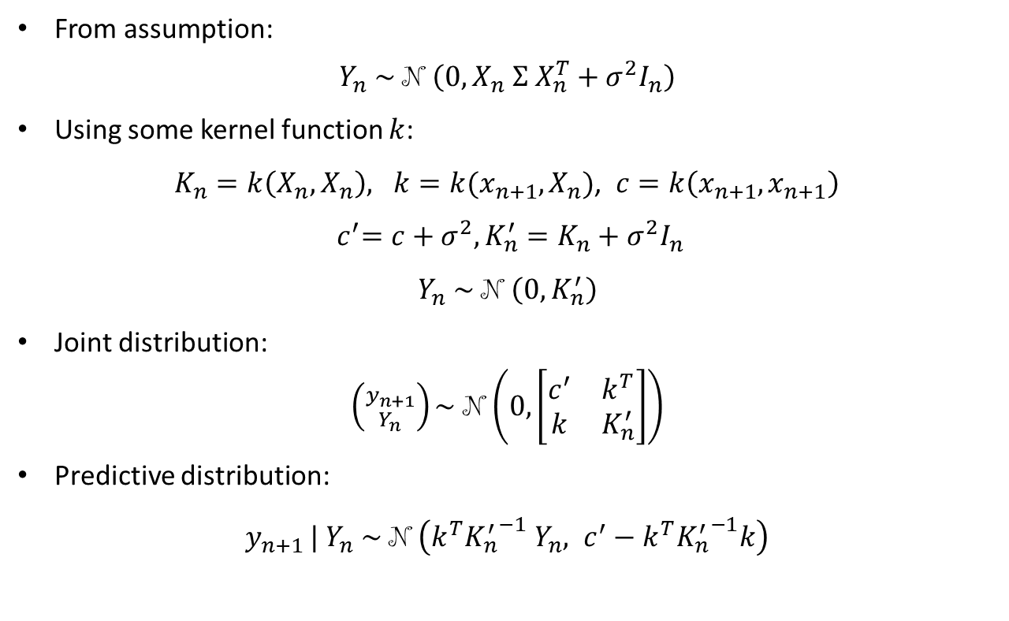
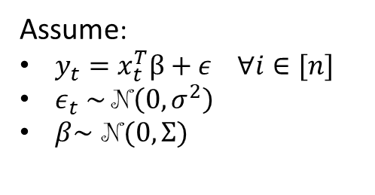
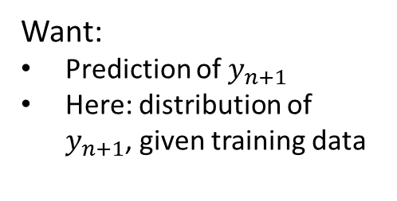
Multitask Gaussian Process
Given:
$x_{t}∈ℝ^{m}, y_{t}∈ℝ$
$\left\{\left(x_{1},y_{1}\right), ..\left(x_{n}, y_{n}\right)\right\}$
$x_{n+1}$
Gaussian Process · Multitask Gaussian Process
Assume:
$y_{t}=x_{t}^{T}β+ε ∀i∈[n]$
$ε_{t} \sim$N$\left(0, σ^{2}\right)$
$β\sim$ N$(0, Σ)$
From assumption:
$Y_{n} \sim \text{N}$ $\left(0, X_{n} Σ X_{n}^{T}+σ^{2}I_{n}\right)$
Using some kernel function $k$:
$K_{n}=k\left(X_{n}, X_{n}\right), k=k(x_{n+1}, X_{n})$, $c=k\left(x_{n+1}, x_{n+1}\right)$
$${ c}^{′}=c+σ^{2},K_{n}^{′}=K_{n}+σ^{2}I_{n}$$
$Y_{n} \sim \text{N}$ $\left(0, K_{n}^{′}\right)$
Joint distribution:
$\left({y_{n+1} \atop Y_{n}}\right)\sim \text{N}$ $\left(0, \left[\begin{matrix}c^{′} & k^{T} \\ k & K_{n}^{′}\end{matrix}\right]\right)$
Predictive distribution:
$y_{n+1 }| Y_{n} \sim \text{N}$ $\left(k^{T}{K_{n}^{′}}^{−1} Y_{n}, c^{′}−k^{T}{K_{n}^{′}}^{−1}k\right)$
Want:
Prediction of $y_{n+1}$
Here: distribution of $y_{n+1}$, given training data

Slide 8
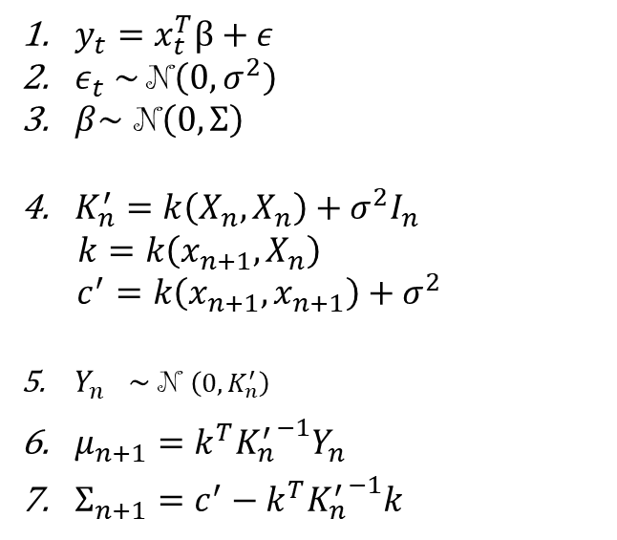
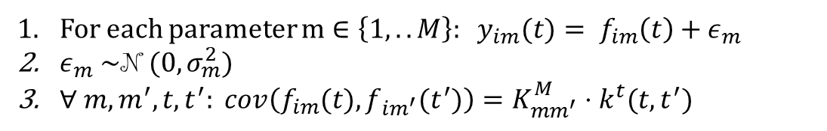
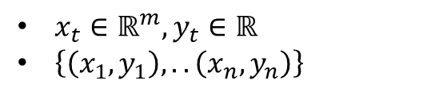
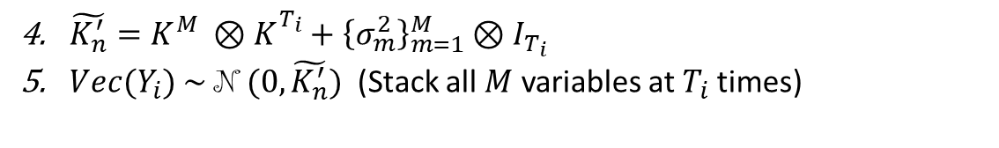
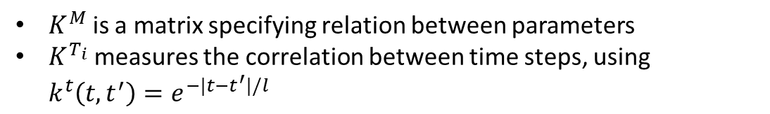
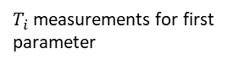
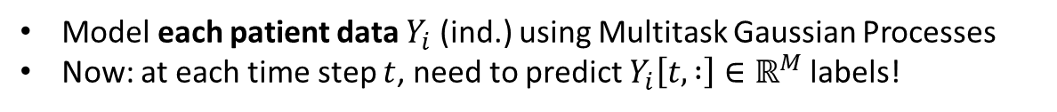
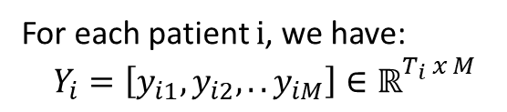
Multitask Gaussian Process
Gaussian Process
$x_{t}∈ℝ^{m}, y_{t}∈ℝ$
$\left\{\left(x_{1},y_{1}\right), ..\left(x_{n}, y_{n}\right)\right\}$
Gaussian Process · Multitask Gaussian Process
$y_{t}=x_{t}^{T}β+ε$
$ε_{t} \sim$N$\left(0, σ^{2}\right)$
$β\sim$ N$\left(0, Σ\right)$
$K_{n}^{′}=k\left(X_{n}, X_{n}\right)+σ^{2}I_{n}$
$$k=k\left(x_{n+1}, X_{n}\right)$$
$c^{′}=k\left(x_{n+1}, x_{n+1}\right)+σ^{2}$
${Y_{n}}^{}\sim \text{N}$ $\left(0, K_{n}^{′}\right)$
$μ_{n+1}=k^{T}{K_{n}^{′}}^{−1}Y_{n}$
$Σ_{n+1}=c^{′}−k^{T}{K_{n}^{′}}^{−1}k$
Model each patient data $Y_{i}$ (ind.) using Multitask Gaussian Processes
Now: at each time step $t$, need to predict $Y_{i}\left[t, :\right]∈ℝ^{M}$ labels!
For each parameter $m∈{\left\{1,..M\right\}: y}_{im}(t)= f_{im}\left(t\right)+ε_{m}$
$ε_{m} \sim \text{N}$ $(0, σ_{m}^{2})$
$∀ m,m^{′},t,t^{′}: cov\left(f_{im}(t),f_{im^{′}}(t^{′})\right)=K_{mm^{′}}^{M}⋅k^{t}(t, t^{′})$
$K^{M}$ is a matrix specifying relation between parameters
$K^{T_{i}}$ measures the correlation between time steps, using $k^{t}\left(t, t^{′}\right)=e^{−|t−t^{′}|/l}$
$\tilde{K_{n}^{′}}=K^{M} ⊗K_{}^{T_{i}}+{\left\{σ_{m}^{2}\right\}}_{m=1}^{M}⊗I_{T_{i}}$
${Vec(Y}_{i}) \sim$ $\text{N}$ $(0,\tilde{K_{n}^{′}})$ (Stack all $M$ variables at $T_{i}$ times)
Our Data
For each patient $i$, we have:
$$Y_{i}=\left[y_{i1},y_{i2},..y_{iM}\right]∈ℝ_{}^{T_{i} x M}$$
$T_{i}$ measurements for first parameter

Slide 9

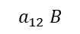
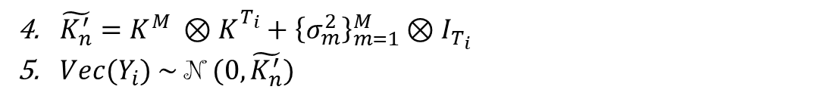
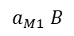
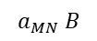
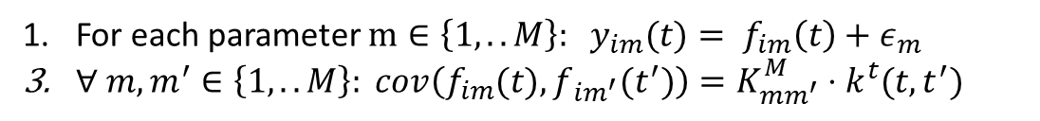
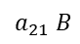
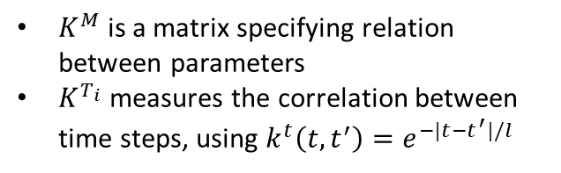
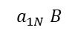
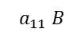
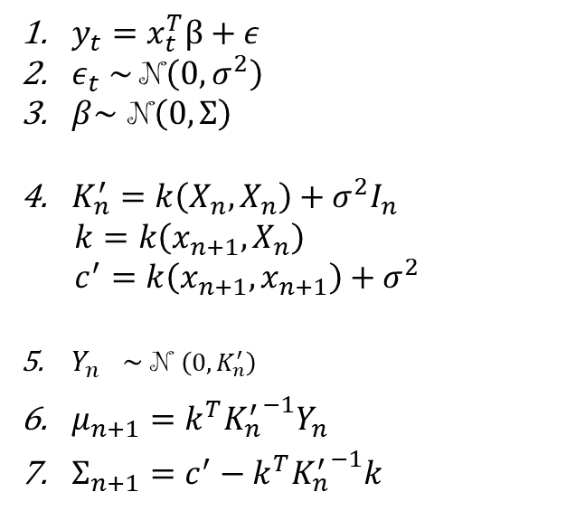
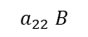
Multitask Gaussian Process
Gaussian Process
$x_{t}∈ℝ^{m}, y_{t}∈ℝ$
$\left\{\left(x_{1},y_{1}\right), ..\left(x_{n}, y_{n}\right)\right\}$
Gaussian Process · Multitask Gaussian Process
$y_{t}=x_{t}^{T}β+ε$
$ε_{t} \sim$N$\left(0, σ^{2}\right)$
$β\sim$ N$\left(0, Σ\right)$
$K_{n}^{′}=k\left(X_{n}, X_{n}\right)+σ^{2}I_{n}$
$$k=k\left(x_{n+1}, X_{n}\right)$$
$$c^{′}=k\left(x_{n+1}, x_{n+1}\right)+σ^{2}$$
${Y_{n}}^{}\sim \text{N}$ $\left(0,K_{n}^{′}\right)$
$μ_{n+1}=k^{T}{K_{n}^{′}}^{−1}Y_{n}$
$Σ_{n+1}=c^{′}−k^{T}{K_{n}^{′}}^{−1}k$
For each parameter $m∈{\left\{1,..M\right\}: y}_{im}(t)= f_{im}\left(t\right)+ε_{m}$
$∀ m,m^{′}∈\left\{1,..M\right\}: cov\left(f_{im}(t),f_{im^{′}}(t^{′})\right)=K_{mm^{′}}^{M}⋅k^{t}(t, t^{′})$
$\tilde{K_{n}^{′}}=K^{M} ⊗K_{}^{T_{i}}+{\left\{σ_{m}^{2}\right\}}_{m=1}^{M}⊗I_{T_{i}}$
${Vec(Y}_{i}) \sim$ $\text{N}$ $(0,\tilde{K_{n}^{′}})$
Interlude: Kronecker Product $⊗$
Let $A∈ℝ^{M x N}, B∈ℝ^{P x Q}$then:$A⊗B∈ℝ^{M⋅P x N⋅Q}$
$$a_{11} B$$
$$a_{12} B$$
$$a_{1N} B$$
Notation
$$a_{21} B$$
$$a_{22} B$$
$K^{M}$ is a matrix specifying relation between parameters
$K^{T_{i}}$ measures the correlation between time steps, using $k^{t}\left(t, t^{′}\right)=e^{−|t−t^{′}|/l}$
….
….
$$a_{M1} B$$
….
$$a_{MN} B$$

Slide 10
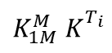
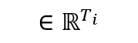
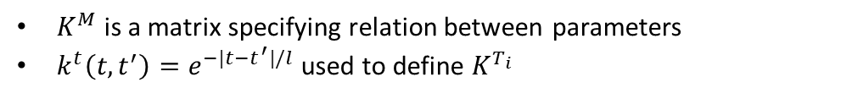
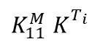
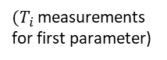
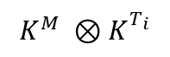
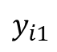
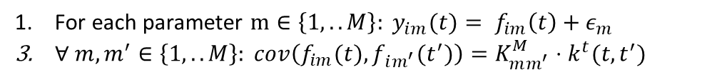
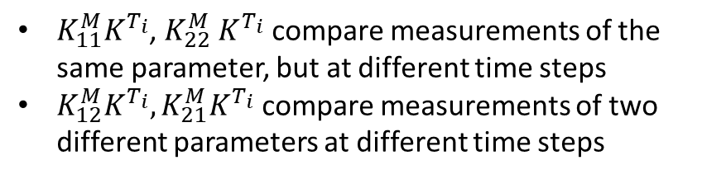
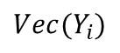
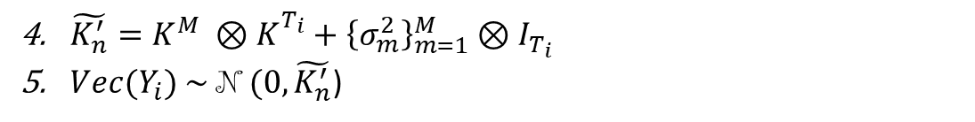
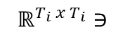
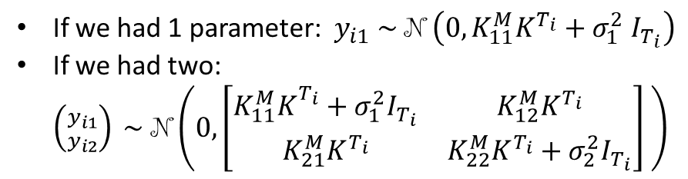
Multitask Gaussian Process
Notation
$K^{M}$ is a matrix specifying relation between parameters
$k^{t}\left(t, t^{′}\right)=e^{−|t−t^{′}|/l}$ used to define $K^{T_{i}}$
Our Assumptions
Gaussian Process · Multitask Gaussian Process
For each parameter $m∈\left\{1,..M\right\}: y_{im}(t)= f_{im}\left(t\right)+ε_{m}$
$∀ m,m^{′}∈\left\{1,..M\right\}: cov\left(f_{im}(t),f_{im^{′}}(t^{′})\right)=K_{mm^{′}}^{M}⋅k^{t}(t, t^{′})$
$\tilde{K_{n}^{′}}=K^{M} ⊗K_{}^{T_{i}}+{\left\{σ_{m}^{2}\right\}}_{m=1}^{M}⊗I_{T_{i}}$
${Vec(Y}_{i}) \sim$ $\text{N}$ $(0,\tilde{K_{n}^{′}}$)
Intuition on covariance
$${Vec(Y}_{i})$$
$$K^{M} ⊗K_{}^{T_{i}}$$
If we had 1 parameter: $y_{i1} \sim \text{N}$ $\left(0, K_{11}^{M}K^{T_{i}}+σ_{1}^{2} I_{T_{i}}\right)$
If we had two: $\left({y_{i1} \atop y_{i2}}\right) \sim \text{N}\left(0, \left[\begin{matrix}K_{11}^{M}K_{}^{T_{i}}+σ_{1}^{2}I_{T_{i}} & K_{12}^{M}K^{T_{i}} \\ K_{21}^{M}K^{T_{i}} & K_{22}^{M}K^{T_{i}}+σ_{2}^{2}I_{T_{i}}\end{matrix}\right] \right)$
$$ℝ^{T_{i} x T_{i}}∋$$
$$K_{11}^{M} K_{}^{T_{i}}$$
…
$$K_{1M}^{M} K_{}^{T_{i}}$$
$$y_{i1}$$
$$∈ℝ^{T_{i}}$$
………
$K_{11}^{M}K^{T_{i}}$, $K_{22}^{M} K^{T_{i}}$ compare measurements of the same parameter, but at different time steps
$K_{12}^{M}K^{T_{i}}, K_{21}^{M}K^{T_{i}}$ compare measurements of two different parameters at different time steps
$(T_{i}$ measurements for first parameter)

Slide 11
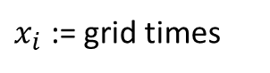
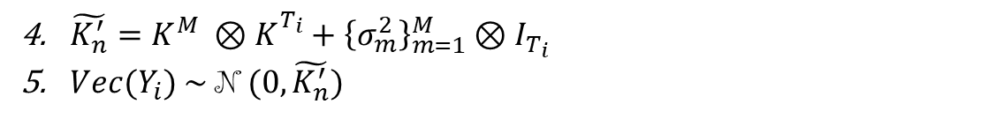
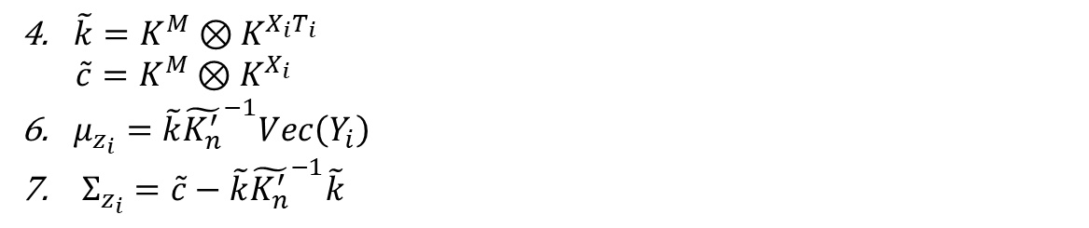


Multitask Gaussian Process
Gaussian Process
$K_{n}^{′}=k\left(X_{n}, X_{n}\right)+σ^{2}I_{n}$
$$k=k\left(x_{n+1}, X_{n}\right)$$
$${ c}^{′}=k\left(x_{n+1}, x_{n+1}\right)+σ^{2}$$
${Y_{n}}^{}\sim \text{N}$ $\left(0,K_{n}^{′}\right)$
$μ_{n+1}=k^{T}{K_{n}^{′}}^{−1}Y_{n}$
$Σ_{n+1}=c^{′} −k^{T}{K_{n}^{′}}^{−1}k$
Gaussian Process · Multitask Gaussian Process
$\tilde{K_{n}^{′}}=K^{M} ⊗K_{}^{T_{i}}+{\left\{σ_{m}^{2}\right\}}_{m=1}^{M}⊗I_{T_{i}}$
${Vec(Y}_{i}) \sim$ $\text{N}$ $(0,\tilde{K_{n}^{′}})$
Predictive distribution
$x_{i}$ := grid times
Then let $z_{i}=Vec(Z_{i})$ be the latent time series values at times $x_{i}$
$\tilde{k}=K^{M}⊗K^{X_{i}T_{i}}$
$\tilde{c}=K^{M}⊗K^{X_{i}}$
$μ_{z_{i}}=\tilde{k}{\tilde{K_{n}^{′}}}^{−1}Vec\left(Y_{i}\right)$
$Σ_{z_{i}}=\tilde{c}−\tilde{k}{\tilde{K_{n}^{′}}}^{−1}\tilde{k}$
Time Axis
Vector of parameters
$K^{X_{i}T_{i}}$ represents the correlation between $x_{i}$ and $t_{i}$ time steps
$K^{X_{i}}$ represents the correlation between $x_{i}$ times steps

Slide 12



RNN Classifier
Dataset · Classifier
Previously…
Now, after Multitask Gaussian Process…
Times of parameters recording
Recorded parameters
$z_{i} \sim \text{N}$ $(μ_{z_{i}},Σ_{z_{i}})$ latent function values
Baseline covariates upon admission
label
$$D_{i}=\left\{b_{i}, t_{i}, Y_{i},P_{i},o_{i}\right\}$$
$$D_{i}=\{z_{i}, b_{i}, P_{i}, o_{i}\}$$
Baseline covariates upon admission
Times and medications administered
Times and medications administered
label
Problems:
$t_{i}$ could be very different between patients: irregular and quite different time steps
Advantages:
Patients $i, j$ have measurement at least until time $x_{it}$, then:
$\left(x_{i1}, x_{i2},..x_{it}\right)={(x}_{j1}, x_{j2},..x_{jt}), i.e.$their grid times coincide.
No more missing data
Preserve uncertainty for future steps
Still, $z_{i}$ can be of different lengths across patients

Slide 13



















RNN Classifier
Dataset
$$D_{i}=\{z_{i}, b_{i}, P_{i}, o_{i}\}$$
$z_{i} \sim \text{N}$ $(μ_{z_{i}},Σ_{z_{i}})$ latent parameter values at evenly spaced time steps
$z_{i}$ may be of different lengths across patients
Dataset · Classifier
Different length time series $→$ Recurrent Neural Network classifier
$$h_{1}$$
$$h_{2}$$
$$h_{3}$$
$$h_{4}$$
LSTM cell
$$c_{1}$$
LSTM cell
$$c_{2}$$
LSTM cell
$$c_{3}$$
LSTM cell
$$c_{4}$$
$$h_{1}$$
$$h_{2}$$
$$h_{3}$$
$$h_{4}$$
$$d_{i1}=[z_{i1}^{T}, b_{i}^{T},p_{i1}^{T}]$$
$$d_{i2}=[z_{i2}^{T}, b_{i}^{T},p_{i2}^{T}]$$
$$d_{i3}=[z_{i3}^{T}, b_{i}^{T},p_{i3}^{T}]$$
$$d_{i4}=[z_{i4}^{T}, b_{i}^{T},p_{i4}^{T}]$$
Medications administered before $x_{i1}$
Medications administered between $x_{i2}$ and $x_{i3}$

Slide 14






Loss Function
Model
Multitask Gaussian Process
$K^{M}$ matrix specifying relation between parameters
$k^{t}\left(t, t^{′}\right)=e^{−|t−t^{′}|/l}$ used to define $K^{T_{i}}$
${\left\{σ_{m}^{2}\right\}}_{m=1}^{M}$ noise variances
RNN Classifier
$f(\{z_{i}, b_{i}, P_{i}\};w)$
Parameters to learn:
$θ=(K^{M},{\left\{σ_{m}^{2}\right\}}_{m=1}^{M}, l)$ from the Multitask Gaussian Process
$w$ parametrizing the RNN classifier
Solution 1:
Using expectation $μ_{z_{i}}$ over $z_{i}$
Loss function: L$(f\left(\left\{z_{i}, b_{i}, P_{i}\right\};w\right), o_{i})$
Challenge:
$z_{i}$ is a random variable
Solution 2:
Take expectation of loss
$$𝔼_{z_{i} \sim \text{N}(μ_{z_{i}}, Σ_{z_{i}};θ)}[L(f\left(\left\{z_{i}, b_{i}, P_{i}\right\};w\right),o_{i})]$$
Problem:
Discard uncertainty information

Slide 15




Loss Function
Model
Multitask Gaussian Process
$K^{M}$ matrix specifying relation between parameters
$k^{t}\left(t, t^{′}\right)=e^{−|t−t^{′}|/l}$ used to define $K^{T_{i}}$
${\left\{σ_{m}^{2}\right\}}_{m=1}^{M}$ noise variances
RNN Classifier
$f(\{z_{i}, b_{i}, P_{i}\};w)$
Parameters to learn:
$θ=(K^{M},{\left\{σ_{m}^{2}\right\}}_{m=1}^{M}, l)$ from the Multitask Gaussian Process
$w$ parametrizing the RNN classifier
Learning Problem:
$$w^{∗}, θ^{∗}=argmin_{w, θ} {\sum_{i=1}^{N}{𝔼_{z_{i} \sim \text{N}(μ_{z_{i}}, Σ_{z_{i}};θ)}[L(f\left(\left\{z_{i}, b_{i}, P_{i}\right\};w\right),o_{i})]}}_{}$$
Reparameterization Trick
$$z=μ_{z}+R⋅ξ$$
$$ξ \sim \text{N}(0,I\text{)}\text{, }Σ_{z}=RR^{T}$$
intractability
$$𝔼_{z_{i} \sim \text{N}(μ_{z_{i}}, Σ_{z_{i}};θ)}\left[L\left(f\left(\left\{z_{i}, b_{i}, P_{i}\right\};w\right),o_{i}\right)\right]≈\frac{1}{S} \sum_{s=1}^{S}{L(f\left(\left\{z_{s}, b_{i}, P_{i}\right\};w\right),o_{i})}$$
for $z_{s}\sim \text{N}(μ_{z_{i}}, Σ_{z_{i}};θ$)
${→𝔼}_{ξ}$ is independent from $\left(θ,w\right)$
$→$ Can bring gradients inside expectation

Slide 16

Experiments and Results

Slide 17

Critics
Enjoyable and understandable paper
Provides all the necessary mathematical details
Notation was rather clear
Clear Experiments showing ML superiority

Slide 18
Thank you for your attention
Questions?

Slide 19
Appendix: Future Work
Name | Model Descr. |  |  | Date
MGP-AttTCN | MGP (similar as here) | Attention (over parameters and time) | Time Convolutional Neural Network (TCN outperform RNN) | 2021
Model-Based Reinf. Learning | Learn Environment model: change of patient physiological state | Policy search (clinician policy,..) |  | 2018
Deep Learning | Convolutional NN | LSTM |  | 2019
Heterogeneous Event Aggregation | Embedding | Attention | LSTM | 2019

Slide 20


Appendix: Gaussian Process
Gaussian Process
$x_{t}∈ℝ^{m}, y_{t}∈ℝ$
$\left\{\left(x_{1},y_{1}\right), ..\left(x_{n}, y_{n}\right)\right\}$
Derivation of 5.
$y_{t}=x_{t}^{T}β+ε$
$ε_{t} \sim$N$\left(0, σ^{2}\right)$
$β\sim$ N$\left(0, Σ\right)$
$K_{n}^{′}=k\left(X_{n}, X_{n}\right)+σ^{2}I_{n}$
$$k=k\left(x_{n+1}, X_{n}\right)$$
$${ c}^{′}=k\left(x_{n+1}, x_{n+1}\right)+σ^{2}$$
${Y_{n}}^{}\sim \text{N}$ $\left(0,K_{n}^{′}\right)$
$μ_{n+1}=k^{T}{K_{n}^{′}}^{−1}Y_{n}$
$Σ_{n+1}=c^{′}−k^{T}{K_{n}^{′}}^{−1}k$
$𝔼y_{t}=𝔼{(x}_{t}^{T}β+ε)=x_{t}^{T}𝔼β+𝔼ε=x_{t}^{T}0+0=0$
$Var\left(y_{t}\right)=Var\left(x_{t}^{T}β+ε\right)=Var\left(x_{t}^{T}β\right)+Var\left(ε\right)=x_{t}^{T}Var\left(β\right)x_{t}+σ^{2}$
$=x_{t}^{T}Σx_{t}+σ^{2}=k\left(x_{t},x_{t}\right)+σ^{2}$
$Cov\left(y_{i}, y_{j}\right)=𝔼\left(y_{i}∗y_{j}\right)−𝔼y_{i}⋅𝔼y_{j}=𝔼\left(\left(x_{i}^{T}β+ε_{i}\right)\left(x_{j}^{T}β+ε_{j}\right)\right)$
$=𝔼\left[x_{i}^{T}βx_{j}^{T}β+x_{i}^{T}βε_{j}+ε_{i}x_{j}^{T}β+ε_{i}ε_{j}\right]=𝔼 x_{i}^{T}β{\left(x_{j}^{T}β\right)}^{T}$
$=𝔼x_{i}^{T}ββ^{T}x_{j}=x_{i}^{T}𝔼ββ^{T}x_{j}=x_{i}^{T}Σx_{j}=k(x_{i}, x_{j})$

Slide 21

Appendix: Gaussian Process
Gaussian Process
$x_{t}∈ℝ^{m}, y_{t}∈ℝ$
$\left\{\left(x_{1},y_{1}\right), ..\left(x_{n}, y_{n}\right)\right\}$
Derivation of 6/7.
$$Lemma 1:$$
$x \sim$N$\left(μ, Σ\right) →\log{p\left(x\right) }$∝ $−\frac{1}{2} x^{T}Σ^{−1}x+x^{T}Σ^{−1}μ,$
$proof.$
To prove this we use the proportional notation ∝, which allows us to discard all terms not depending on $x.$
$\log{p\left(x\right)}$ ∝ $−\frac{1}{2}{\left(x−μ\right)}^{T}Σ^{−1}\left(x−μ\right) \text{∝}−\frac{1}{2}x^{T}Σ^{−1}x+x^{T}Σ^{−1}μ$
$y_{t}=x_{t}^{T}β+ε$
$ε_{t} \sim$N$\left(0, σ^{2}\right)$
$β\sim$ N$\left(0, Σ\right)$
$K_{n}^{′}=k\left(X_{n}, X_{n}\right)+σ^{2}I_{n}$
$$k=k\left(x_{n+1}, X_{n}\right)$$
$${ c}^{′}=k\left(x_{n+1}, x_{n+1}\right)+σ^{2}$$
${Y_{n}}^{}\sim \text{N}$ $\left(0,K_{n}^{′}\right)$
$μ_{n+1}=k^{T}{K_{n}^{′}}^{−1}Y_{n}$
$Σ_{n+1}=c^{′}−k^{T}{K_{n}^{′}}^{−1}k$

Slide 22


Appendix: Gaussian Process
Gaussian Process
$x_{t}∈ℝ^{m}, y_{t}∈ℝ$
$\left\{\left(x_{1},y_{1}\right), ..\left(x_{n}, y_{n}\right)\right\}$
Derivation of 6/7.
$y_{t}=x_{t}^{T}β+ε$
$ε_{t} \sim$N$\left(0, σ^{2}\right)$
$β\sim$ N$\left(0, Σ\right)$
$K_{n}^{′}=k\left(X_{n}, X_{n}\right)+σ^{2}I_{n}$
$$k=k\left(x_{n+1}, X_{n}\right)$$
$${ c}^{′}=k\left(x_{n+1}, x_{n+1}\right)+σ^{2}$$
${Y_{n}}^{}\sim \text{N}$ $\left(0{,K}_{n}^{′}\right)$
$μ_{n+1}=k^{T}{K_{n}^{′}}^{−1}Y_{n}$
$Σ_{n+1}=c^{′}−k^{T}{K_{n}^{′}}^{−1}k$
Let $\left({y_{n+1} \atop Y_{n}}\right)\sim$N $\left(0,\left[\begin{matrix}c^{′} & k^{T} \\ k & K_{n}^{′}\end{matrix}\right]\right).$
We want to find the distribution of $y_{n+1}| Y_{n} \sim \text{N}\text{(}μ,Σ\text{).}$
Let $Λ= \left(\begin{matrix}Λ_{c} & Λ_{k} \\ Λ_{k}^{T} & Λ_{n}\end{matrix}\right)={\left[\begin{matrix}c^{′} & k^{T} \\ k & K_{n}^{′}\end{matrix}\right]}^{−1}.$ We start by treating $Y_{n}$ as constant.
$$\log{p\left({y_{n+1} \atop Y_{n}}\right)\text{∝}−\frac{1}{2}{{\left({y_{n+1} \atop Y_{n}}\right)}^{T}\left(\begin{matrix}Λ_{c} & Λ_{k} \\ Λ_{k}^{T} & Λ_{n}\end{matrix}\right)}^{ }\left({y_{n+1} \atop Y_{n}}\right)}$$
$\text{∝}− \frac{1}{2}y_{n+1}^{T}Λ_{c}y_{n+1}−y_{n+1}^{T}Λ_{k}Y_{n}$
$→Σ=Λ_{c}^{−1}$ and $μ_{a|b}=−Λ_{c}^{−1}Λ_{k}Y_{n}$ (Lemma 1)
Using the identities $Λ_{c}={\left(c^{′}−k^{T}{K_{n}^{′}}^{−1}k\right)}^{−1}$ and $Λ_{k}=−Λ_{c}k^{T}{K_{n}^{′}}^{−1}$ , we obtain:
$μ=k^{T}{K^{′}}_{n}^{−1}Y_{n}$ and $Σ_{a|b}=c^{′} −k^{T}{K^{′}}_{n}^{−1}k.$

